Slide 1


Understanding Request Fields

Slide 2
For trainer’s eyes only, to help you plan out your session, put an outline of the workshop here with timings
Time | Slides | Quick Description
0-5 minutes | 2-3 | Intro
5-10 minutes | 5-6 | Understanding the Field Guidelines hierarchy flowchart
10-30 minutes | 7-11 | Name, telephone, email, URL guidelines
30-40 minutes | 12-13 | Street 1 & 2 fields guideline
40-45 minutes | 14 | Parent Geo field guideline
45-55 minutes | 15-16 | Description and Hours fields guideline
55-70 minutes | 17-24 | Sorting activity (15 mins)
70-85 minutes | 25 | Ollie’s Helpers (15 mins)
85-90 minutes | 26-27 | Recap, Q&A & Feedback
Link to Sort it out activity
Link to Ollie’s Helpers Game

Slide 3

1. Review the Field Guidelines Hierarchy to understand what source is best
2. Learn how to navigate the KB to apply good data in Street 1 & 2 and Postal Code
3. Understand the guidelines for all fields

Slide 4

Notes:
Don’t spend too much time on this activity. Just spend 2-3 minutes on this knowledge recall activity.
TELL: Let’s have a quiz as a quick revision on what we have learned yesterday.
ASK:
What are the three main placetypes? (Restaurants, Accommodations, Attractions)
Which tool do we use to process candidates? (Calypso)
Which tool do we use to process updates? (Calypso)
Where can you find the Audit Trail of a request in the LMT? (top menu bar)

Slide 5
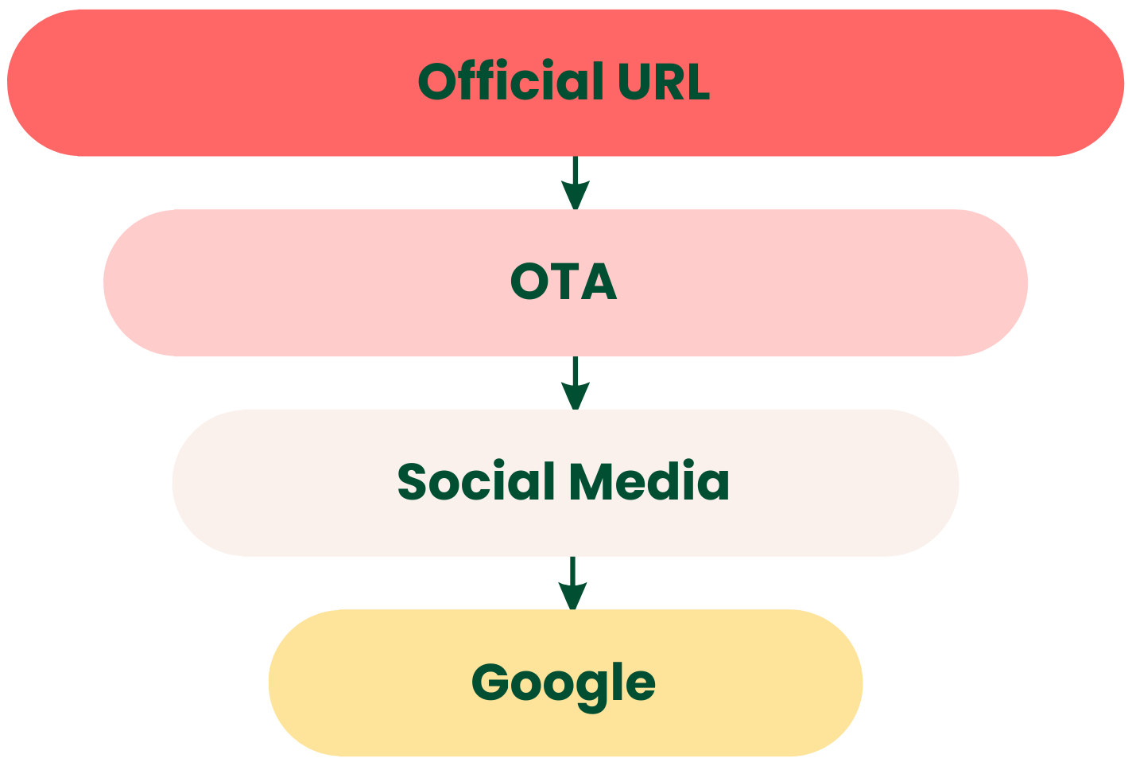
Field Guidelines Hierarchy
Notes:
TELL: When we’re working through a listing, we must keep in mind our field guidelines hierarchy. This is our go to flowchart when we’re pulling data to add to a listing.
(click) First, we should always try to find an official URL. This source is usually the best as it will have the most accurate and up to date information, if it’s available.
(click) If we’re not able to find an official URL, then an OTA (online travel agency) would be the next best source. This is most common for accommodations, as we don’t want to use OTA sites for restaurants and attractions, since these are usually Tripadvisor competitors.
(click) If there is no official URL and no OTA, we would then move to Social Media, such as Facebook, Instagram, Twitter, Youtube, and TikTok.
(click) And lastly, if none of the above are available, we would use Google.

Slide 6




Which source should we use?
Official Name
Official Name
Street 1
Phone
Email
Street 1
Email
Look for the source with the most information and stick to that one source
Notes:
TELL: Now, (click) keep in mind that we don’t want to make things harder for ourselves, and find different pieces of data on multiple sources.
We should look for the source with the most information and stick to that one source. So, for example, (click) let’s pretend a listing has no official URL and their Facebook is accurate and up to date, we should stick to that source for all of the field data we need. (click)

Slide 7

Name, Telephone, Email, URL, Description & Hours
Guidelines
Notes:
TELL: Let’s go over the guidelines for name, telephone, email, URL and description.

Slide 8
Name
The listing’s name should
only be the property's
official name as it appears on an official source.
Notes:
TELL: (read slide)
A few other things to remember about the listing name is that it should not include:
Subtitles
Over the top capital letters
Geo information
Registered Trademark or Trademark symbols
Star ratings
ASK: If we received a new listing request and the name was Omni Parker House ★★★★★, is this acceptable?
EXPLAIN: Remember, we don’t want any stars or star ratings in the official name.

Slide 9

Telephone
The telephone number
should be the public phone number of the property and should
come from an official source.
Notes:
TELL: (read slide)
The reason why we want to ensure that we have an accurate and local phone number is because our live site will connect travellers with the listing and make the call by clicking the number.
It’s okay for us to add a phone number found on a business's Google listing if that is the only one available.
We don’t want to include extensions and we also don’t want to include multiple phone numbers. Only one phone number should be saved on the listing.
Keep in mind that phone numbers from OTAs are usually not acceptable because the data on an OTA is normally a booking phone number. Adding a local number is always best.

Slide 10

Email
Email should be the official contact and/or owner email for the property
Make sure it follows the standard
email format: name@domain.com
Any email address that matches the business's domain is allowed
Any email listed as a point of contact on the business/place's website or social media pages is allowed
Notes:
TELL: We should not use email addresses found on third party websites unless, of course, it matches the email you see on the:
business/place's website
social media pages
Or it matches the business/place's website domain. If you are unable to verify an email address but the domain matches the official name of the business, this is okay to accept.

Slide 11





URL
Official URLs can be:
Official website
Official social media page
Notes:
TELL: We can use and official website or official social media page for the listing’s URL.
If there is no official website or the social media page has more accurate, updated information, we should use this social media hierarchy:
(click) Facebook
(click) Instagram
(click) Twitter
(click) Youtube
(click) TikTok
ASK: If a listing had a Yelp link as the URL, do you think this is acceptable?
EXPLAIN: We don't want Tripadvisor linking to competitors, such as Yelp or Foursquare so this kind of data would be rejected.

Slide 12

Street 1 & 2
Street 1 should contain all or most of the street information used as
the OFFICIAL address of a business
Street 2 can contain any additional street/address information
aside from street name and street number, such as directional information.
For example:
Floor location within a building (e.g. 2/F)
Corner of/next to x building
Across from x landmark
Example: 7 Soho Square, London, England
Street 1: 7 Soho Square
Street 2: (blank)
Notes:
DO: Go over the points on the slide
TELL: If there is a clear street name and street number in the address, those values must go into Street 1.
If you find directional or non-specific information and you have confirmed it to be the only or main official address that the business uses on most places online, it should be saved in Street 1.

Slide 13
Street 1 & 2
When in doubt, ensure Street 1 is NOT left blank!
Exceptions when Street1 is left blank:
Food trucks (unless they have one permanent location)
Tour companies that don’t have one permanent meeting/departure point
Street 1: 7
Street 2: Soho Square
Street 1: 7 Soho Square
Street 2: (blank)
Street 1 & 2 should never contain:
Geo data (city or any higher level)
Postal code
P.O Box
Plus codes
Any other value that belongs in another field on the form
Notes:
TELL: There’re some more guidelines on Street1 & Street2 fields.
Green bubble:
Sometimes Street1 may contain a lot of address details in one line, and it might be hard for you to identify what goes into which field. If you are unsure, save the data in Street1 and make sure it’s not left blank!
If there is address info in Street2, there is no reason to have a blank Street1, so you should move it to Street1 if Street1 is blank.
Yellow bubble:
Sometimes Street 1 can be left blank, e.g. Food trucks (unless they have one permanent location), Tour companies that don’t have one permanent meeting/departure point
We’ll cover these again when we work on the Restaurants and Attractions modules.
Pink bubble:
If the street name and street number are split between Street1 and Street2 on the request, BOTH must be moved to Street 1.
Red bubble:
Street 1 & 2 should never contain:
Geo data (city or any higher level)
Postal code
P.O Box
Plus codes
Any other value that belongs in another field on the form

Slide 14

Parent Geo
We only list a place in the city/town where it is physically located.
When a place is in between
two other cities/towns, we may list it in the city/town closest to the place.
Notes:
DO: (read slide)
TELL: For the scenario where a place is in between two other cities/towns, it’s actually pretty rare that this happens. But just in case you come across a request like this, there’s a KB article on geo research guidelines that you can reference to.
Remember, it’s extremely important that we list a place in the correct geo.
A listing will display on the live site according to its parent geo. Saving the wrong geo means a listing will display under the wrong city. This creates a poor experience when a member is using our site and looking for listings in specific locations.

Slide 15
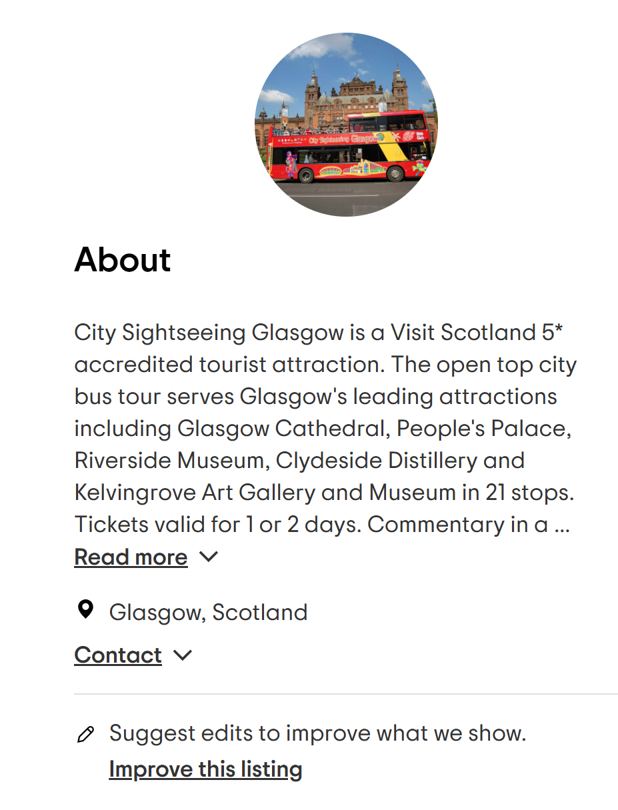
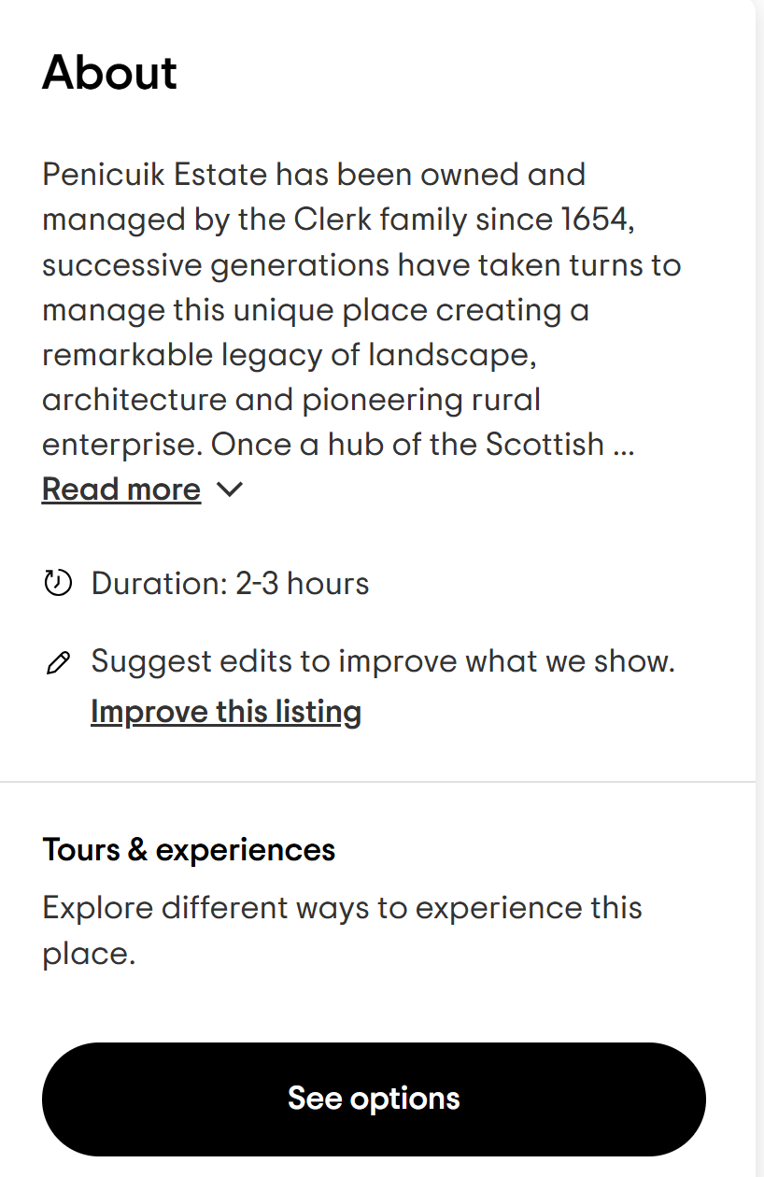
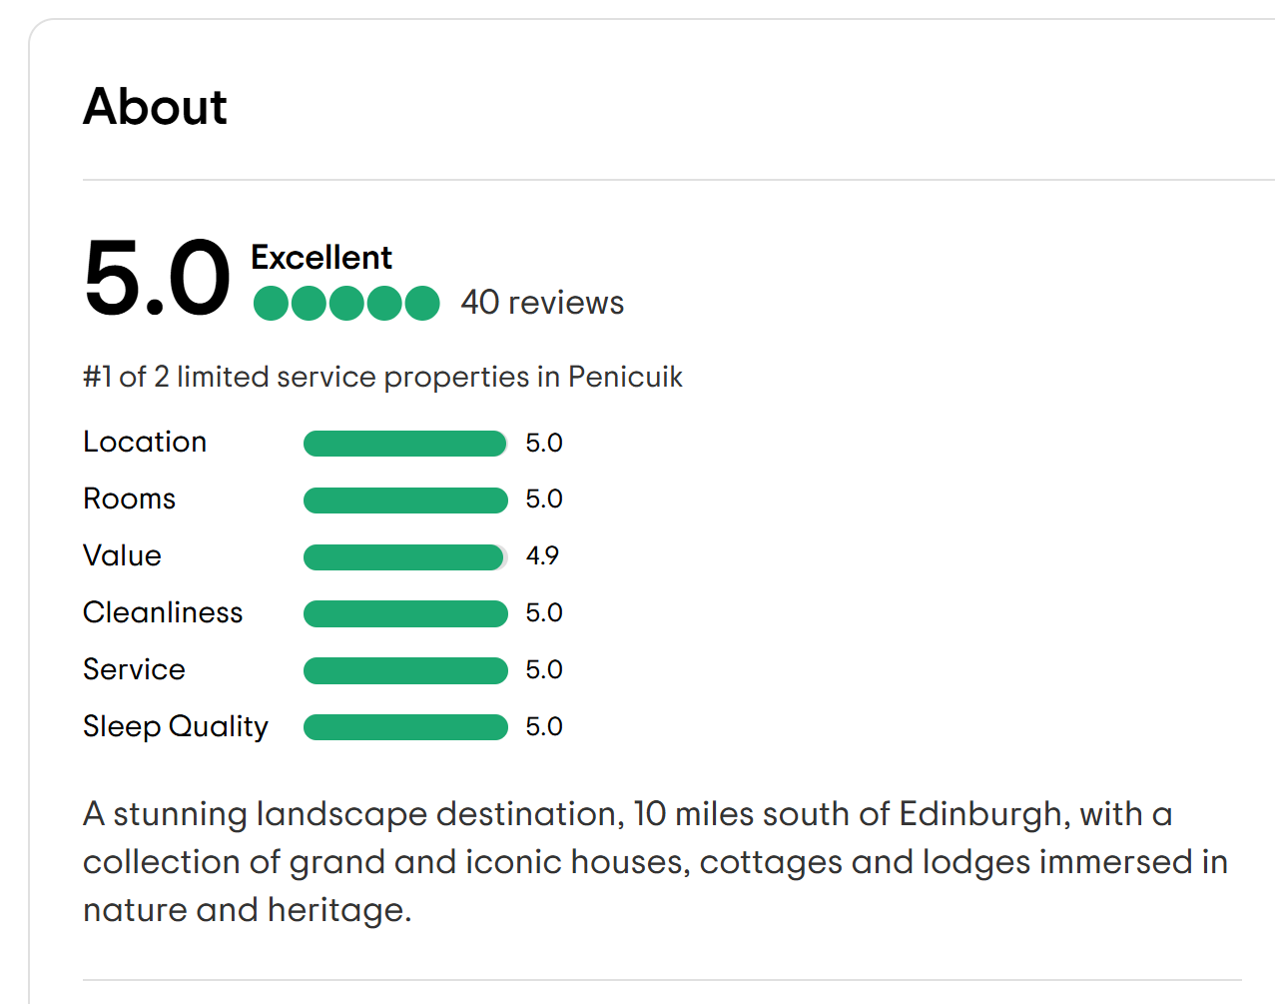
Description
The description should be information about the business and its services.
It should not include:
Star ratings (e.g. Ocean Hotel ★★★★★)
Promotional language
Contact info
Messages directed at Tripadvisor
(e.g. threatening legal action)
Tripadvisor URLs
Notes:
TELL: The next data field we should check is Description. As you can see on these three images, the Description fields is seen under the "About" heading on all 3 placetypes on our live site.
Go over the slide content.
For promotional language: This refers to language that offers discounts or incentives to customers in exchange for reviews.
For example:
Leave a 5-star review and get a 10% discount!
Mention Tripadvisor when you you come for a free appetizer!
Write a review and enjoy a complimentary dessert on your next visit!
If you come across a description that includes these wordings, make sure to remove only the bad content, and you can keep the rest of the description that describes the place.
TELL: Keep in mind that innocent, general statements like:
Come visit us for delicious food!
Check out Instagram for awesome pics of our tours.
Call us for more information.
Are okay to have in the description.

Slide 16

Hours
A listing’s hours of operation should be added if it’s available when researching.
Notes:
DO: (read slide)
TELL: Hours of operation (hours) should always be added to the Location Hours section of Calypso and/or LMT when found. Even if it’s not part of the request and the information is available on the official source, agents should add this data.
Our tools express hours in a 24 hour format (military time).
Hours is the only field that can be excluded from the hierarchy we talked about a little earlier.
If you encounter different hours on social media that don't have recent updates compared to the hours listed on Google, it's acceptable to use the information listed on Google, as it may receive updates more frequently. Hours should NOT be a compilation of hours found on multiple sources. Choose one source and have the listing reflect that information.
Let’s take a look at what hours looks like in our tools.
Trainer’s eyes only:
Open Calypso and LMT to show agents where they will see the Location Hours in the tools, how they can edit those fields and how to enter the time using the 24 hour format.
TELL: No matter what queue you’re working in, these field guidelines for all of these fields we just reviewed represent our ideal level of accuracy.

Slide 17

Sort It Out
Request Fields Activity
Correct
Link to interactive
game board
Incorrect
Notes:
Activity duration: 15 mins
Objective: Apply the fields guidelines.
Related KB: https://tripadvisor.atlassian.net/wiki/spaces/ASK/pages/300102857/Field+Guidelines+and+Research+Expectations
Game board link: https://view.genially.com/677fa3f243e37473b375d7b9
Trainer Info:
There are two rounds. Each round has 10 cards with statements or data.
Trainer will share the interactive game board link with the agents. Agents will be working in groups.
Correct answers on Slide 14 and 15.
DO: Split agents into groups of 3-4.
TELL:
Agents will work in groups. Each group will be responsible for sorting the cards. One agent will display the Genially board for discussion among the team
Explain that their task is to collaboratively discuss and decide whether each of the cards should be placed in the "Correct" or "Incorrect" pile.
Each group will have a set amount of time (e.g., 15 minutes) to review the cards and sort them on the game board.

Slide 18
Round 1 answers
Correct
Incorrect
Street 1:
123 Tremont St.
URL:
www.instagram.com/
rios_tapasbar/
Name:
Copley Hotel
5 Stars!!!
Email:
mphilippe@tripadvisor.com
Phone:
+44 7836 2300
Phone:
+34 930 12 12 70
Street 1:
South Dr. Rizal Park Manila
Description:
www.tripadvisor.com/Hotel_Review-g187147-d229968…
Email:
info@jarasushi.com
Name:
Thai Tanic ™
Notes:
[For Trainer’s eyes only]
TELL: Here is the overview of all the cards.
(trainer: go over any other tricky cards that agents had the wrong answer to prior to starting the next round.)

Slide 19
Round 2 answers
Correct
Incorrect
Description:
Call us for more info!
Name:
The Watergate Hotel
URL:
www.yelp.com/biz/the-queens-arms-london
Street 2:
400 1st Avenue
URL:
www.theverbhotel.com/
Street 1:
5 Lowell Street
Street 2:
2nd floor
Street 1:
47th & 48th floors
Street 2:
1535 Broadway
Street 1:
02215
Description:
The most amazing French food in the area. Come and see!
Phone:
617-426-1400
Ext. 231
Notes:
TELL: Here is the overview of all the cards.
(trainer: go over any other tricky cards that agents had the wrong answer to prior to reviewing the 5 tricky cards)

Slide 20
Street 1:
47th & 48th floors
Street 2:
1535 Broadway
CORRECT
INCORRECT
Notes:
Info for trainer: Go over the following tricky cards on Slide 16-20.
ASK: Do these fields have the right data?
EXPLAIN: This is incorrect because the street address should be in Street 1 and the directional information should be in Street 2.

Slide 21
Description:
Call us for more info!
CORRECT
INCORRECT
Notes:
ASK: What about this description?
EXPLAIN: This might seem like promotional text but innocent, general statements like this is okay to be in a listing’s description.

Slide 22
Name:
Thai Tanic ™
CORRECT
INCORRECT
Notes:
ASK: Is this name okay to keep on a listing?
EXPLAIN: This is incorrect because trademark symbols should not be part of the official name.

Slide 23
Name:
Copley Hotel
5 Stars!!!
CORRECT
INCORRECT
Notes:
ASK: Do we think this is correct or incorrect?
EXPLAIN: Listing names should not include any stars or star ratings.

Slide 24
Street 1:
5 Lowell Street
Street 2:
2nd floor
CORRECT
INCORRECT
Notes:
ASK: Is Street 1 and Street 2 fine in this example?
EXPLAIN: We can have directional information in Street 2 since we have a valid street number and name in Street 1.

Slide 25

Ollie’s
Helpers
Can you help Ollie to deliver all presents?
Notes:
Objective: Apply the field guidelines, particularly on Street 1 & Street 2 and postal code
Activity duration: 15 mins
TELL: You will be playing this game on your own. In this game, you’ll be helping Ollie to deliver presents by correctly applying the street addresses based on the field guidelines, particularly on Street 1 & Street 2 and postal code.
TELL: Recall what you have learnt in this module and apply correct field data about the street addresses. You can refer to the KB to help you answer the questions!
DO: Trainer will make sure agents can access the game board.
Interactive game: https://view.genial.ly/65cb9eb9c76a8c0014451666/interactive-content-street-1-and-street-2-postal-code
For Trainer’s reference:
Be ready to answer agents’ questions
Questions and answers for trainer’s reference: https://docs.google.com/spreadsheets/d/1Fb-Yxhp1QekeSPaVDMojoA8N-NSY_yW4pf7So9W1d2g/edit?gid=0#gid=0

Slide 26
Translation & Transliteration
LATIN LANGUAGES
Czech Italian
Danish Norwegian
Dutch Polish
English Portuguese
Finnish Slovak
French Spanish
German Swedish
Hungarian Turkish
Icelandic Welsh
Indonesian
NON-LATIN LANGUAGES
Arabic
Chinese
Greek
Hebrew
Japanese
Korean
Russian
Taiwanese
Vietnamese
Thai
Notes:
TELL: When you’re processing, there are specific expectations depending on if the language is a Latin language or a non-Latin language.
Latin languages use the same alphabet as the English language, while non-Latin languages use their own alphabet and/or characters.

Slide 27
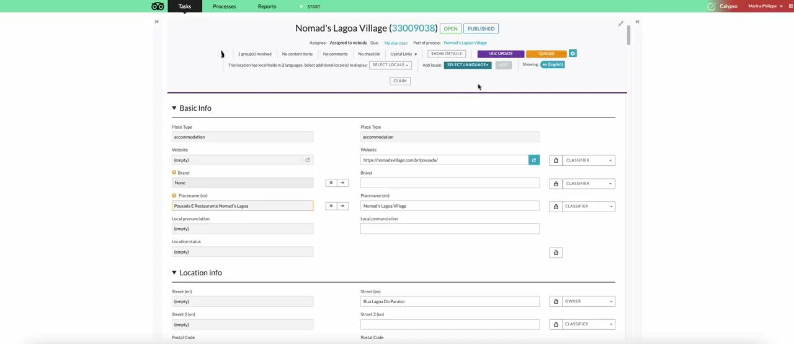
Local Fields in Calypso
Notes:
TELL: So what does this look like when you’re processing?
When you’re working in Calypso, you’ll initially see the EN fields, also known as the primary fields.
In order to see the local fields, you will need to select the locale from the drop down as shown in this clip.
Then you’ll see the primary fields (EN) and the local field(s).

Slide 28
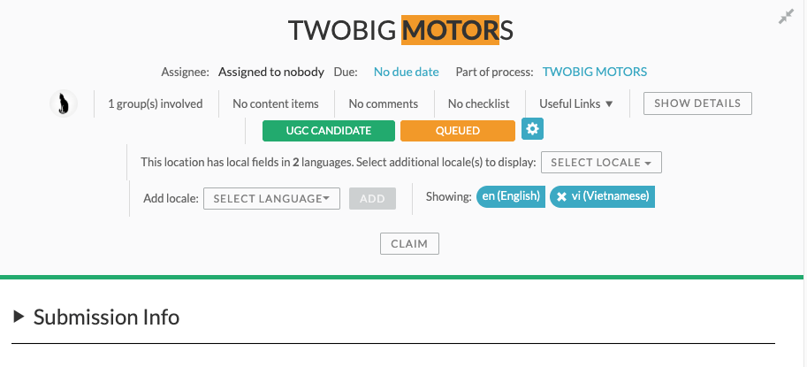
Notes:
TELL: You will also be able to tell if the request has local fields by looking at the top of the request here (click).

Slide 29
LATIN
NAME, STREET 1 & STREET 2 FIELDS ONLY
Apply the correct data to the primary field
Delete the local field
NON-LATIN
NAME, STREET 1 & STREET 2 FIELDS ONLY
Transliterate the data using:
  Google Translate
  Yandex
  Baidu (Chinese)
Apply the transliteration to the local field
UGC Candidates:
You will have to keep the data in the Name local field if it’s part of the request, as the tool does not allow for the field to be left blank.
More info on Latin vs. Non-Latin languages can be found in our KB here!
Latin vs. Non-Latin Languages
Notes:
TELL: When you’re processing, you’ll need to check the local fields for only Name, Street 1 & Street 2.
DO: Read the slide
TELL: We’ll go over this more throughout the next few days and we’ll learn what it looks like to process requests that have local fields for both Latin and non-Latin languages.

Slide 30
1. Review the Field Guidelines Hierarchy to understand what source is best
2. Learn how to navigate the KB to apply good data in Street 1 & 2 and Postal Code
3. Understand the guidelines for all fields

